Slide 1
Introduction to Energy Systems
Review & Module 1
Introduction Energy and Power (Review)
Introduction to Energy Issues (Module 1)
Prepared by: Prof. Amin Ghobeity
Please do not distribute without permission

Slide 2

References
Instructor Notes
Energy Systems Engineering: Evaluation and Implementation, 4th Ed.
McGraw-Hill, New York, 2016

Slide 3
Part 1
Introduction to Energy and Power

Slide 4
Energy
Energy
Kinetic energy
Potential energy
Internal / Thermal energy
Work
    Work is performed when a force moves an object through a distance.
    Work and energy have same units
Work = (force)(distance)

Slide 5
Units of Work
SI unit: Joule (J)
1 J = (1 N)(1 m)
US Customary unit: pound-force-ft (lbf·ft)
1 lbf·ft = (1 lbf)(1 ft)
1J ≈ 0.74 lbf·ft
1 lbf·ft ≈ 1.4 J

Slide 6
Difference Between Energy and Power
Power represents the amount of work done or energy expended per unit of time.

Slide 7

Units of Power
SI unit: Watt (W)
U.S. Customary units: pound force-ft per second $\left(\frac{lbf·ft}{s}\right)$
horsepower (hp)
(= 1.36 Watts)
(= 746 W = 0.746 kW)

Slide 8
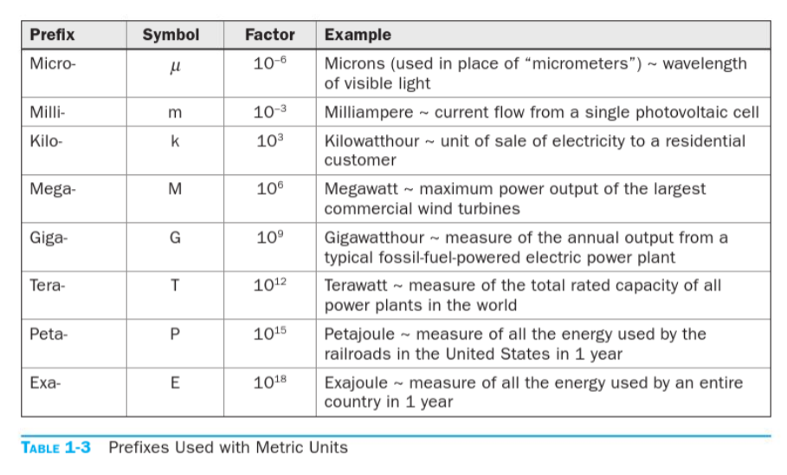
Prefixes used with metric units of energy

Slide 9
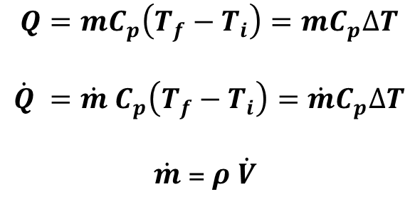
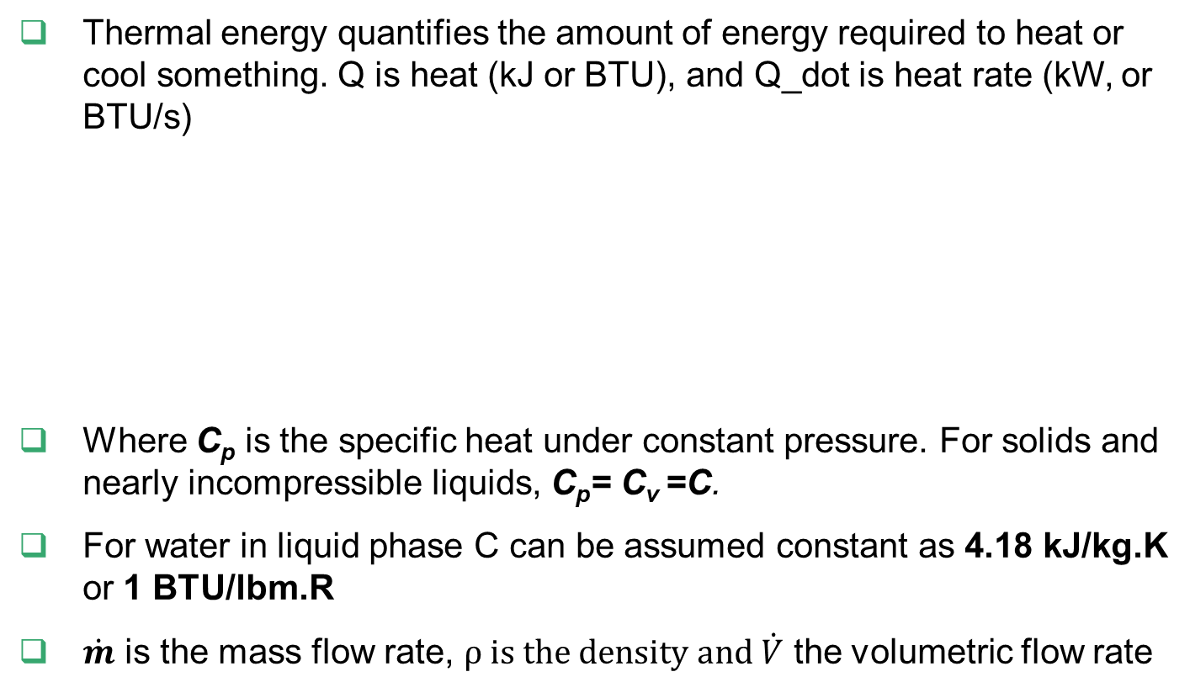
Thermal Energy
Thermal energy quantifies the amount of energy required to heat or cool something. Q is heat (kJ or BTU), and Q_dot is heat rate (kW, or BTU/s)
Where C_{p} is the specific heat under constant pressure. For solids and nearly incompressible liquids, C_{p}= C_{v} =C.
For water in liquid phase C can be assumed constant as 4.18 kJ/kg.K or 1 BTU/lbm.R
$\dot{m}$ is the mass flow rate, $ρ is the density and \dot{V}$ the volumetric flow rate
$$Q=mC_{p}\left(T_{f}−T_{i}\right)=mC_{p}∆T$$
$$\dot{Q} =\dot{m} C_{p}\left(T_{f}−T_{i}\right)=\dot{m}C_{p}∆T$$
$\dot{m}$ = $ρ$ $\dot{V}$

Slide 10
Units of Thermal Energy
British thermal unit (Btu)
The amount of thermal energy needed to raise the temperature of one pound mass (lbm) of water by one degree Fahrenheit (°F).
Calorie
The amount of heat required to raise the temperature of one gram (g) of water by one degree Celsius (°C).
1,000 calories = 1 Calorie
SI unit: joule (J)
1 Btu = 1,055 joules 1 Btu = 252 calories
1 calorie = 4.186 joules

Slide 11
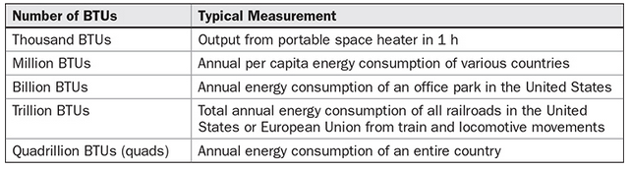
U.S. Standard Customary Units
One BTU is defined as sufficient energy to raise the temperature of 1 lbm of water by 1°F at a starting temperature of 39.1°F. At other starting temperatures, the amount of heat required varies slightly from 1 BTU, but this discrepancy is small and is ignored in this course.
1 BTU is equivalent to 1055 J. The units BTU/second (equivalent to 1.055 kW) and BTU/hour (equivalent to 3.798 MW) can be used to measure power.
A unit of 1 quadrillion BTU (10¹⁵ BTU) is called a quad. Typical quantities associated with increasing orders of magnitude of BTU measurements are given in Table 1-5.

Slide 12

Energy Content (Heating Values) of Fuels
Heating value of a fuel
The amount of energy that is released when a unit mass (kilogram or pound) or a unit volume (cubic meter, cubic foot, or gallon) of a fuel is burned
Lower heating value (LHV): When the water leaves as a vapor.
Higher heating value (HHV): When the water in the combustion gases is completely condensed and thus the heat of vaporization is also recovered.

Slide 13
Energy Content of Common Fuels
Fuel | Quantity | Average Energy Content
Coal | One pound | 10,000 Btu (10.5×10⁶ J)
Diesel | One gallon | 139,000 Btu (146.6×10⁶ J)
Gasoline | One gallon | 124,000 Btu (130.8×10⁶ J)
Fuel Oil (Home Heating Oil) | One gallon | 139,000 Btu (146.6×10⁶ J)
Natural Gas | One cubic foot | 1,000 Btu (1.05×10⁶ J)
Wood | One cord (128 ft³) (4×4×8 feet pile of wood stacked neatly) | 20,000,000 Btu (21.1×10⁹ J)
Note that these values are approximate value and only used for a general “back of the envelope” calculations

Slide 14
Efficiency
A measure of how much input is required to have a desired output.
The efficiency of space heating systems of residential and commercial buildings is usually expressed in terms of the annual fuel utilization efficiency (AFUE), which accounts for the combustion efficiency as well as other losses such as heat losses to unheated areas and start-up and cooldown losses.

Slide 15

Overall efficiency of a power plant
Generator: A device that converts mechanical energy to electrical energy.
Generator efficiency: The ratio of the electrical power output to the mechanical power input.
Thermal efficiency of a power plant: The ratio of the net electrical power output to the rate of fuel energy input.

Slide 16
Energy Efficiency Ratio
Internal combustion engines
Gasoline engine: 25-30%
Diesel engine: 35-40%
Refrigeration and cooling systems
Energy Efficiency Ratio (EER) and Seasonal Energy Efficiency Ratio (SEER).
Both EER and SEER have unit of BTU/Wh
To calculate the annual average power use, divide the A/C’s BTU/h by the SEER rating. For example:
  6,000 BTU/h ÷ 15 SEER = 400 watts (or 0.4 kilowatts)
Air conditioning units have a SEER that is in the range of 10-17
Furnaces
Annual Fuel Utilization Efficiency (AFUE)
High-efficiency furnaces: AFUE 80-96%

Slide 17
Heating and Cooling Units
Refrigeration ton (RT) is a common unit used in HVAC
1 RT = 12,000 Btu/hr
Example:
What is the annual electricity cost of a 3 ton AC unit with SEER of 14 running approximately 1200 hrs/year
“3 ton” AC unit means the AC has a cooling capacity of 36,000 BTU/hr
A 3 ton AC unit with SEER of 14 has average power consumption of 36000 / 14 = 2.57 kW
If the unit runs 1200 hrs/year and electricity cost is 0.16 $/kWh, then total energy cost of the unit is 493.7 $/year

Slide 18
Part 2
Energy Issues

Slide 19
Issues to Consider
Energy Consumption
Energy Consumption per Capita
Energy Consumption vs. GDP
Energy Consumption vs. HDI
Climate Change – Key Issue
Path Forward and Potential Remedies

Slide 20
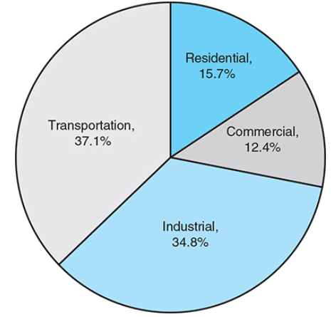
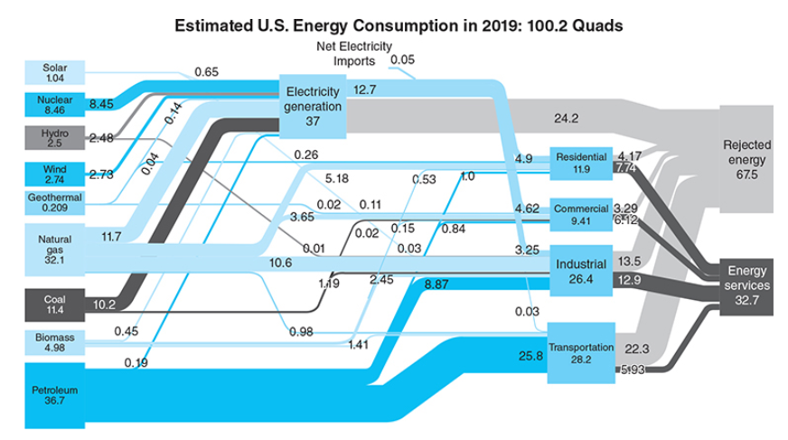
Sources and Distribution of Energy
Importantly, the final services we desire are typically not energy, but energy is the conveyor or enabler of these desired services. Thus, fuel losses, conversion losses and distribution losses occur before the final user, where additional system losses
1 quadrillion BTU (10¹⁵ BTU) is called a quad

Slide 21
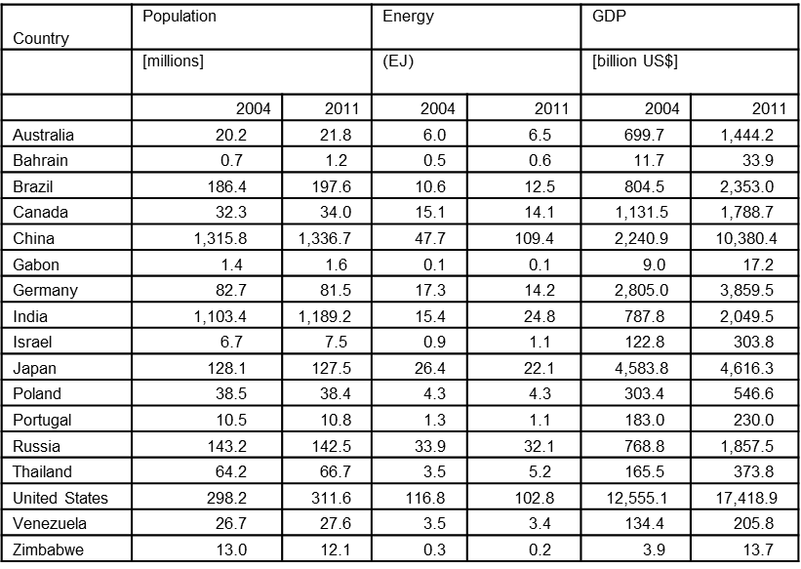
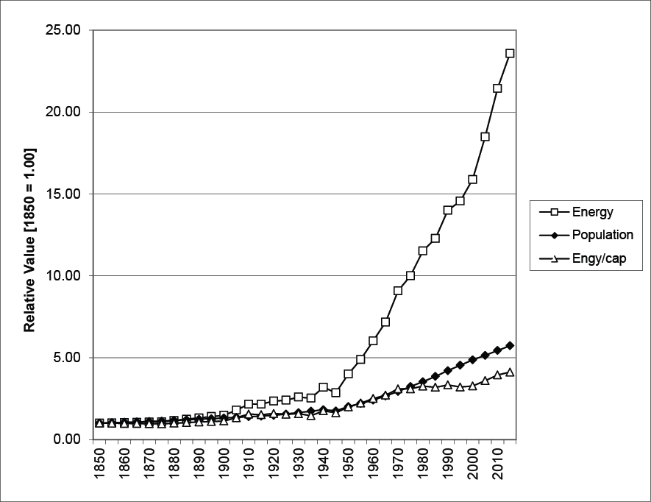
Energy, Population, GDP
Population and energy per capita 1800-2015
Gross domestic product (GDP) is the sum of the monetary values of all goods and services produced in a country. It is the most commonly used measure of wealth

Slide 22
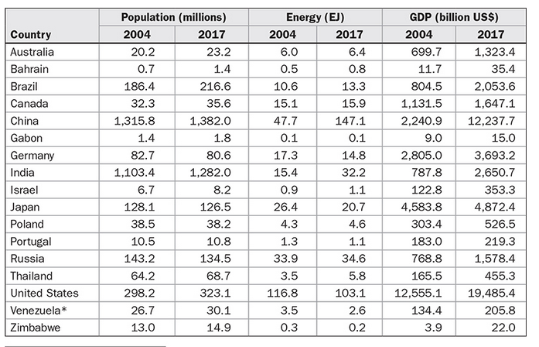
Energy, Population, GDP, 2017 Data

Slide 23
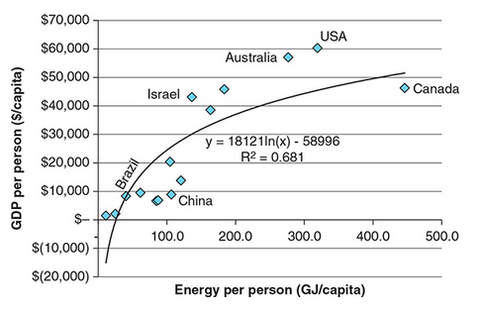
GDP/person vs Energy/person select countries, 2017
Source: F Vanek, L Albright, and L Angenent. (2016) Energy Systems Engineering: Evaluation and Implementation, 3rd Ed., McGraw-Hill.
This slide may be distributed as long as this attribution is maintained with the slide.

Slide 24
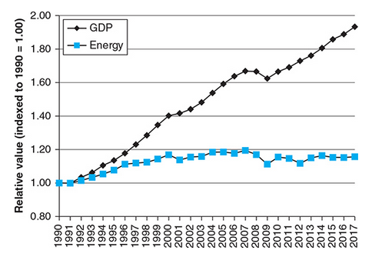
GDP vs Energy Consumption
Historically, growth in GDP has usually accompanied growth in energy demand.
Efficiency, modernization, recycling, and structural economic change (e.g., shift to service economy) can weaken this relationship.
GDP growing faster than energy use reduces energy intensity.
Total energy can still rise even when intensity falls because population and economic growth may outweigh efficiency gains.
Relative values of energy use and real GDP in the United States indexed to 1990 = 1.00, 1990–2017.

Slide 25
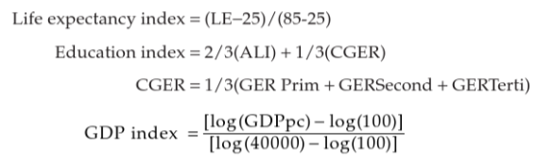
Human Development Index (HDI) vs. Energy per Capita
GDP is not a true measure of prosperity and life quality.
HDI is defined as a better measure of life quality and is compared with energy consumption
HDI is the average of life expectancy index (LEI), GDP index (GDPI), and education index (EI).
LEI is based on adult literacy index (ALI) and combined gross enrollment rate (CGER)
HDI is measured on a scale from 0 (worst) to 1 (best)
Source: F Vanek, L Albright, and L Angenent. (2016) Energy Systems Engineering: Evaluation and Implementation, 3rd Ed., McGraw-Hill.
This slide may be distributed as long as this attribution is maintained with the slide.

Slide 26
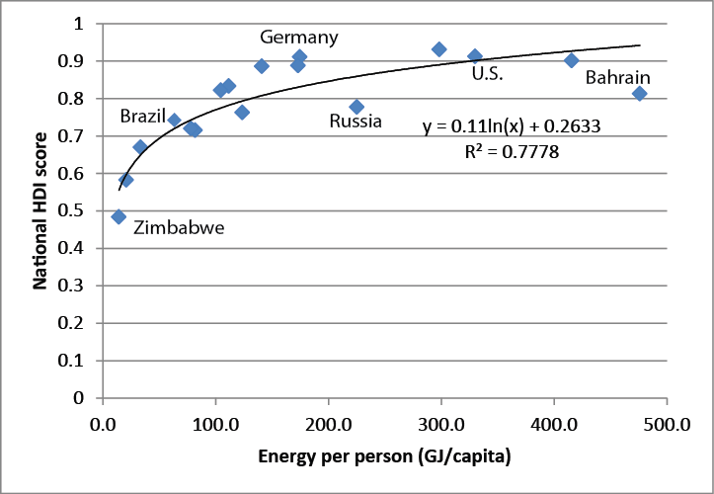
Human Development Index vs Energy/person select countries, 2011

Slide 27
Introduction to Climate Change
Energy use in all its forms, including electricity generation, space and process heat, transportation, and other uses, is the single most important contributor to climate change
  Both energy use and energy per capita have historically increased
The problem of climate change is directly related to the “greenhouse effect,” by which the atmosphere admits visible light from the sun, but traps reradiated heat from the surface of the Earth, in much the same way that a glass greenhouse heats up by admitting light but trapping heat
Gases that contribute to the greenhouse effect are called greenhouse gases (GHGs).

Slide 28
GHGs
GHGs, some are biogenic, or resulting from interactions in the natural world, while others are anthropogenic, or resulting from human activity other than human respiration
  The most important anthropogenic GHG is CO₂, primarily from the combustion of fossil fuels
GHGs include methane (CH₄), nitrous oxide (N₂O), and various human-manufactured chlorofluorocarbons (CFCs).
The contribution to the greenhouse effect of these other GHGs per molecule is greater than that of CO₂, their concentration is much less, so overall they make a smaller contribution to the warming of the atmosphere.
Key issue: There is imbalance of approximately 4 Gt/year of carbon inbound to the atmosphere

Slide 29
Summary of Key Energy and Climate Change Issues
Key climate change concern is the increase in CO2 concentration in atmosphere (steadily increasing and proven to be due to human activities)
Main human activity causing the increase in CO2 concentration is the combustion of fossil fuels
Energy use and energy use per capita both increasing with time
Direct correlation between energy use and GDP
Pre 1950s, it was assumed that imbalance of CO2 were absorbed by the oceans, however later on it was shown that this was not true and increase in CO2 increase earth surface temperature (approximately 0.74+/-0.18 C from 1900 to 2000)
Main effects of global warming: receding glaciers and loss of polar ice, extreme heat events, change in animal, plant, and bird range, coral reef bleaching

Slide 30
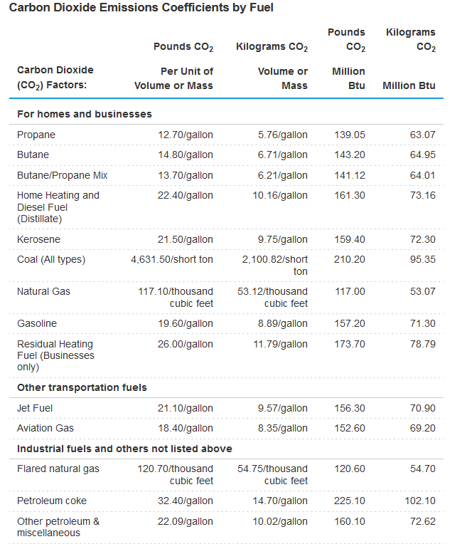
CO₂ Emissions per Fuels

Slide 31
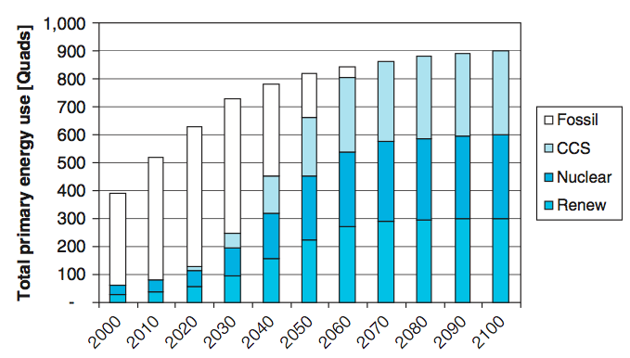
Possible Pathway to 2100
At present nuclear energy contributes about 4% of global primary energy, and renewable energy about 11%, with fossil energy supplying the rest
Nuclear power plays a key role
Carbon capture with sequestration (CCS), will displace conventional fossil
The results, which displace the 85% conventional fossil used in 2000 with a mix of noncarbon emitting sources by 2100
A possible pathway for primary energy production in the 21st century arriving at 100 million BTU/person, on average, available for 9 billion people in 2100

Slide 32
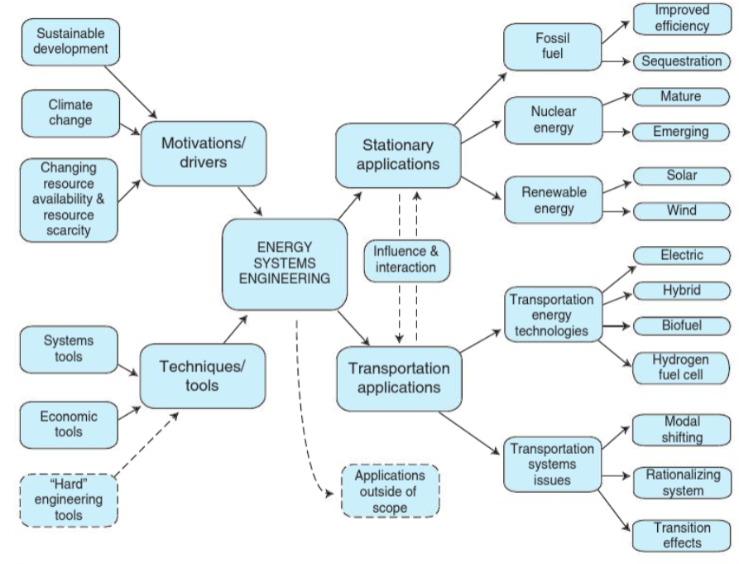
Energy Systems Engineering
Module 4
Module 5
Module 3
Module 6
Module 7
Module 2
Source: F Vanek, L Albright, and L Angenent. (2016) Energy Systems Engineering: Evaluation and Implementation, 3rd Ed., McGraw-Hill.
This slide may be distributed as long as this attribution is maintained with the slide.

